Slide 1
Coinflip Problem
The application of cross tables

Slide 2
Cross Tables
The law of total probability, Bayes rule, and the sum-to-one rule are all properties of probabilities
Quantitative research method appropriate for analyzing the relationship between two or more variables.

Slide 3
Interview Problem
Suppose there are 5 coins. Four of the coins are fair with P(heads)=0.5, and one of the coins is biased with P(heads)=0.75. Suppose a coin is randomly selected and flipped 4 times resulting in 4 heads.
What is the probability that the selected coin was biased? That is, what is P(biased coin selected | HHHH)?

Slide 4
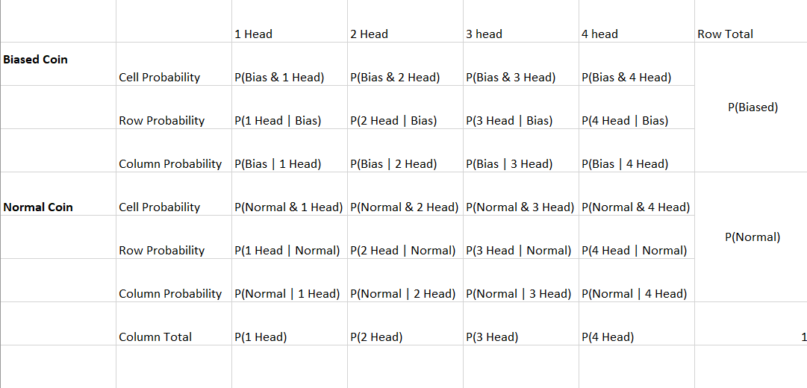
Cross Table Analysis

Slide 5
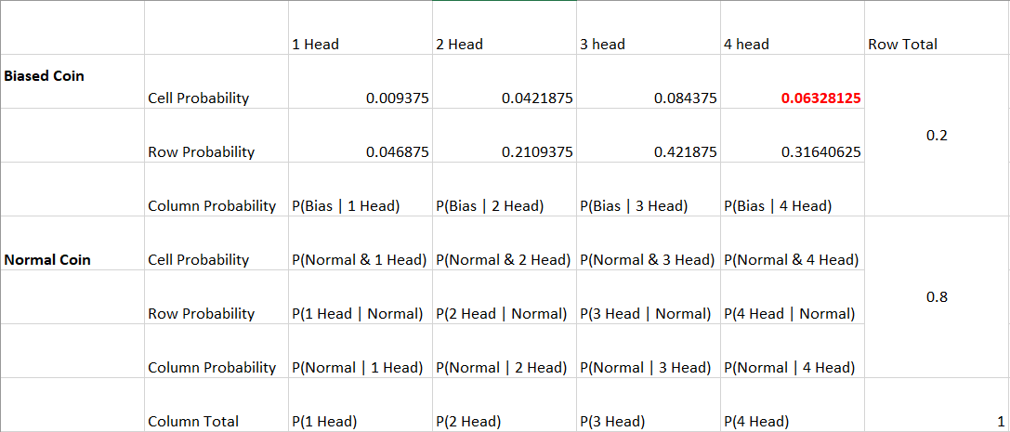
Cross Table Computation

Slide 6
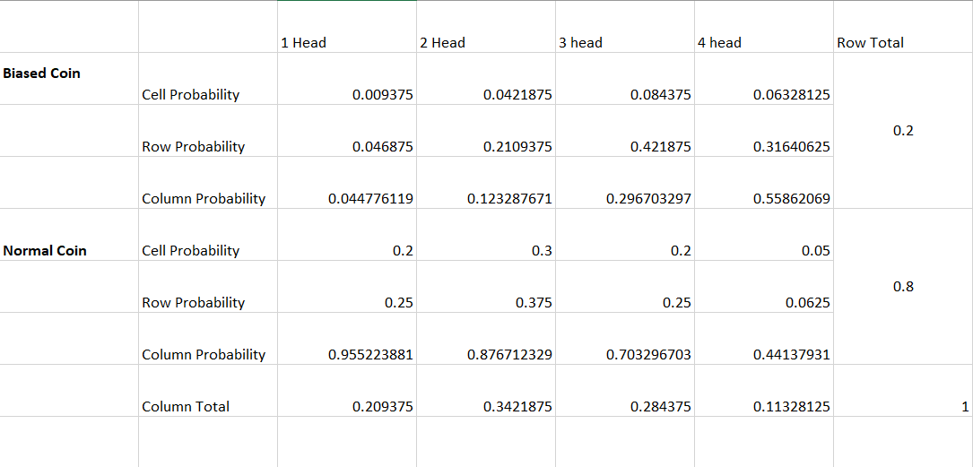
Cross Table Tabulation

